Slide 1

Traditional Method vs Lastest Method
Presented By
Sai Siddarth T S

Slide 2
Objective
Traditional Method:
To deliver a complete and finished product after detailed planning.
Ensure all requirements are gathered before execution begins.

Slide 3
Achievements of Traditional method
Clear project scope and timeline.
Detailed documentation at every phase.
Well-suited for projects with stable and fixed requirements

Slide 4
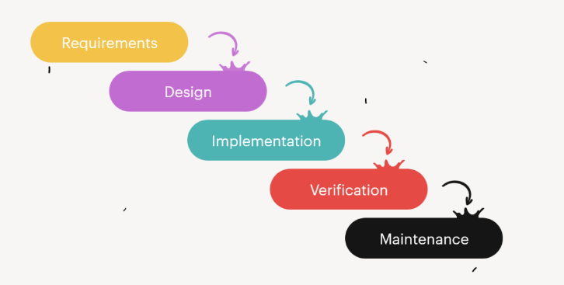
Process of Waterflow Method

Slide 5

1. Late discovery of problems during testing. 2. Less customer involvement after the requirement phase. 3. Long delivery time.
Traditional Method Drawbacks

Slide 6
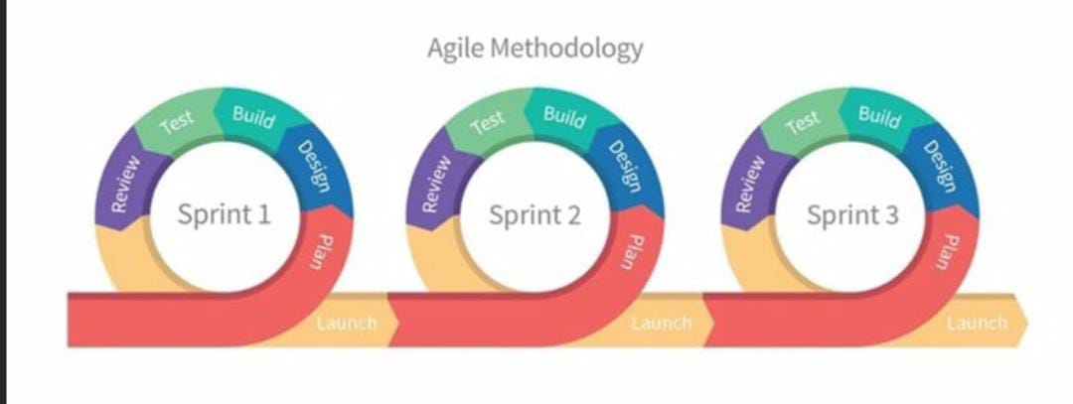
Agile
Iterative and incremental approach.
It has collaboration and customer feedback.
Q3
Market research
Q4
Product development
Q1
User testing
Q2
Product launch
6

Slide 7

Comparison Table
Criteria | Traditional Method | Agile
Planning | Upfront and rigid | Continuous and adaptive
Customer Involvement | Low | High
Delivery | End of Project | Iterative releases
Risk Management | Late stage | Throughout
7

Slide 8
Key Differences
Agile welcomes change, traditional resists it.
Agile Delivery Values faster, Traditional waits until the end.
Agile improves continuously, while traditional methods fix only after failures.
8

Slide 9
Conclusion
Traditional: Best for fixed-scope, predictable projects.
Agile: Best for dynamic, evolving projects.

Slide 10
Thank you

